Slide 1
 | (Metadata columns) | Industrial Animal Farm | Industrial Poultry Farm | Industrial Pig Farm | Industrial Cattle Farm
Cluster 1 | … | ✓
Cluster 2 | … | ✓ | ✓
Cluster 3 | … | ✓ |  |  | ✓
Cluster 4 | … | 𐄂
Final category based on model(s) and/or label
If we have a label

Slide 2
 | (Metadata columns) | Industrial Animal Farm | Industrial Poultry Farm | Industrial Pig Farm | Industrial Cattle Farm
Cluster 1 | … | ✓
Cluster 2 | … | ✓ | ✓
Cluster 3 | … | ✓ |  |  | ✓
Cluster 4 | … | 𐄂
3-class model
Poultry + Other Farm
Poultry

Slide 3
“Training countries”
  BRA, CHL, MEX, THA, USA
  CNN train/val/test; eval set
  IF is fitted to USA-DMV subset only; everything else is available for evaluation
“Generalization countries”
  BGD, NGA (could add more)
  CNN generalization, out-of-distribution
  IF evaluation
“Labeled countries”
  All of the above
  This is what we use for model training/fitting and evaluation

Slide 4
“Inference countries”
  Any other country
  Some have labels available (not yet integrated)
    Argentina, Australia: many FT labels
    Canada, India, Colombia, …: some FT labels
    EU: official dataset
    UK: official dataset
    Various clusters I’ve inspected
  Use for understanding models and assigning final categories
  Why not for model training and formal evaluation?
    CNN training: data balancing, we care about countries that are “not like” Australia, EU, UK
    Model eval: not statistically valid samples
    Model eval: too many numbers to analyse and report!

Slide 5
Eval 1: training country data not used for fitting/training/validation
  CNN: the usual held-out test set
  IF: Everything except DMV
Eval 2: training country representative samples
  Labels are biased
  So, create representative sample using random samples of unlabeled data
  → “eval set”, 100-150 per country
  Exclude these from (1)
Eval 3:generalization country data
  All BGD clusters, 100 random ones from Nigeria
  Tests CNN generalization

Slide 6
Other/Informal evals:
  Confidently-wrong predictions in the training + test countries
    Incorrect labels
    Surprising bad predictions
    Genuinely difficult cases
  Look at stuff in the inference countries
Next slides: 3-Class v3, “Farm” = “Poultry+Other” vs NotFarm

Slide 7
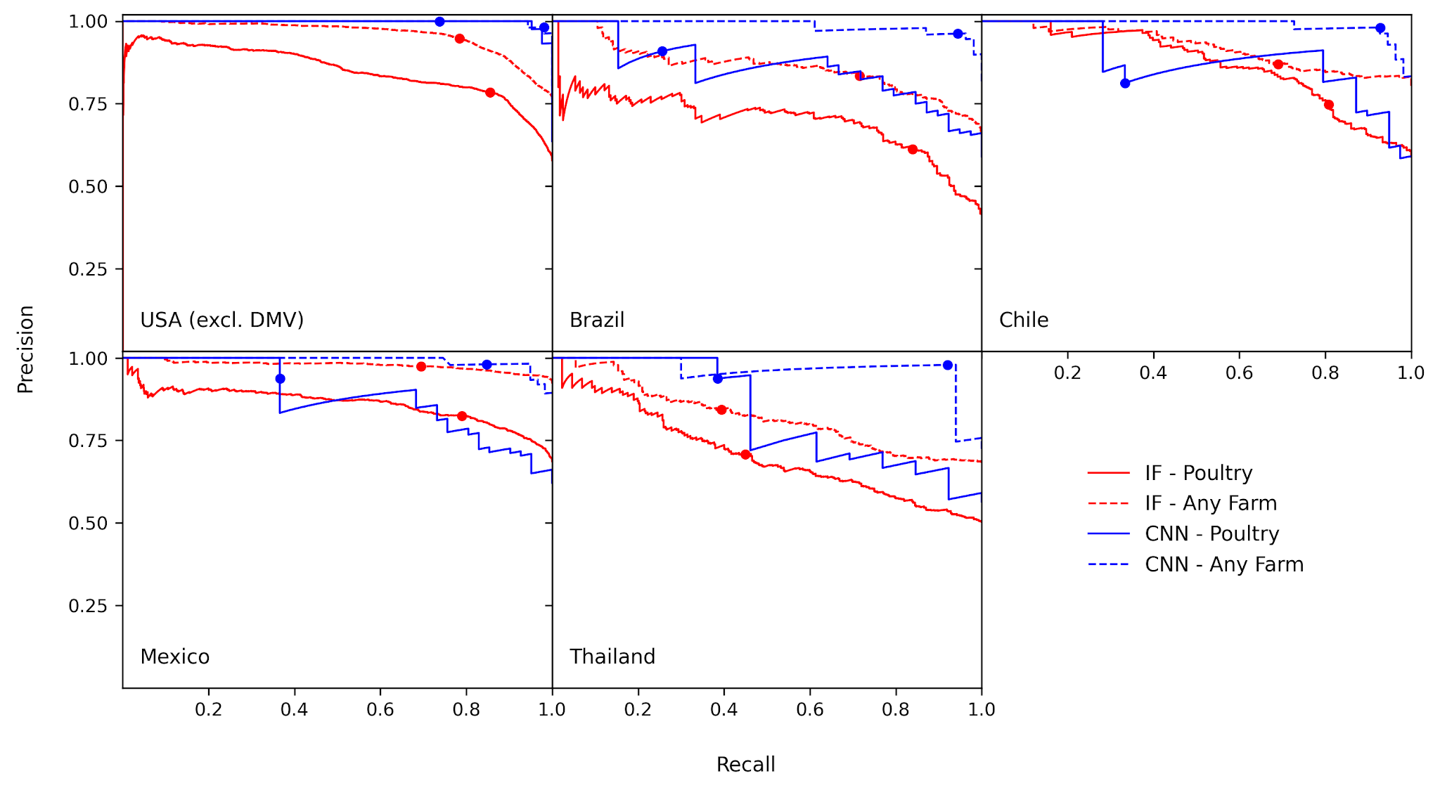
EVAL 1

Slide 8
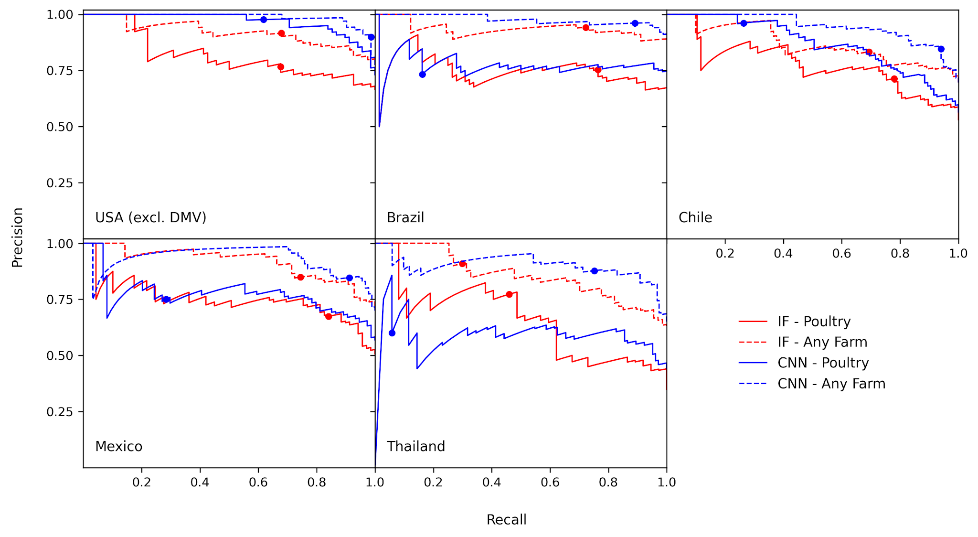
EVAL 2
Number of rows in eval sets looks wrong?

Slide 9
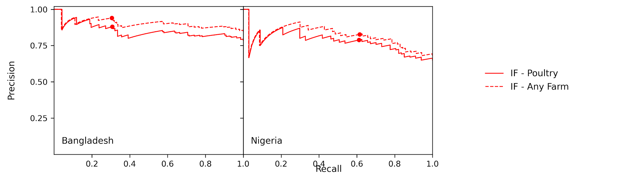
Needs CNN predictions on
BGD_selected_clusters_for_analysis
NGA_selected_clusters_for_analysis
EVAL 3

Slide 10
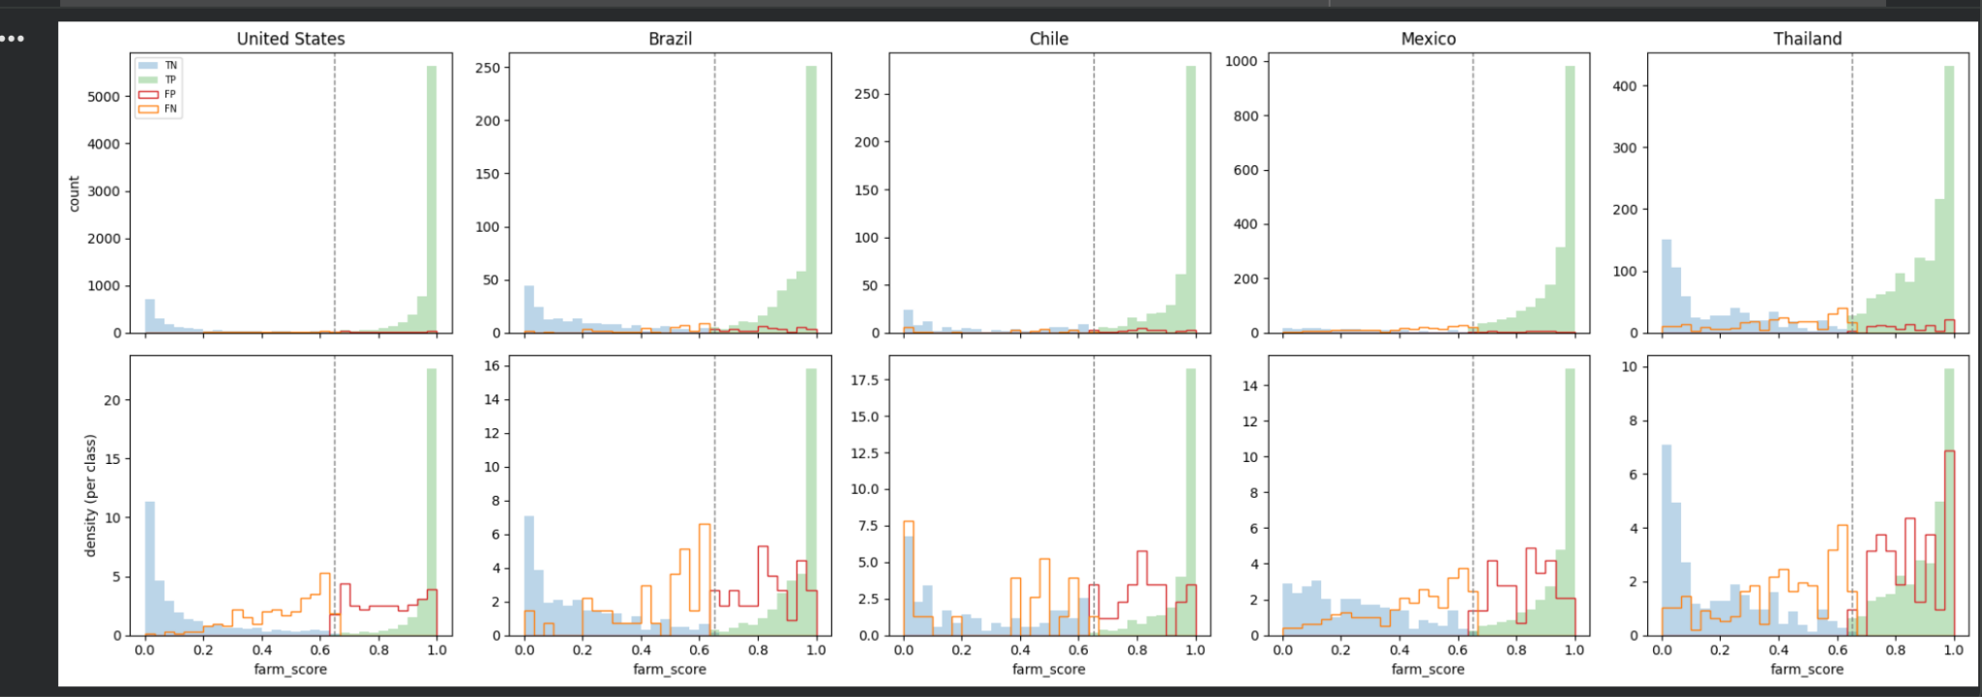
3-class model v3, (Poultry+Other) vs (NotFarm)
Bad labels?? (Propagate original cols if possible)

Slide 11
3-class model v3, (Poultry+Other) vs (NotFarm)
Inference countries - just a quick look!
  Algeria: solar panels not misidentified as farms in the 3-class model (v3)
  Albania: plastic crop covers/greenhouses are frequently misidentified as farms
  I have labeled these as NotFarm; how to use?
  NB these countries do not yet have their _selected_clusters_for_analysis files yet

